Slide 1
Image Restoration
CS 615 – Digital Image Processing
Sharon Kim
Notes:
Hi everyone, my name is Sharon, and my presentation is on Image Restoration using old family photos. I also wanted to determine whether image quality increased after restoration, so I developed some metrics to quantify that.

Slide 2
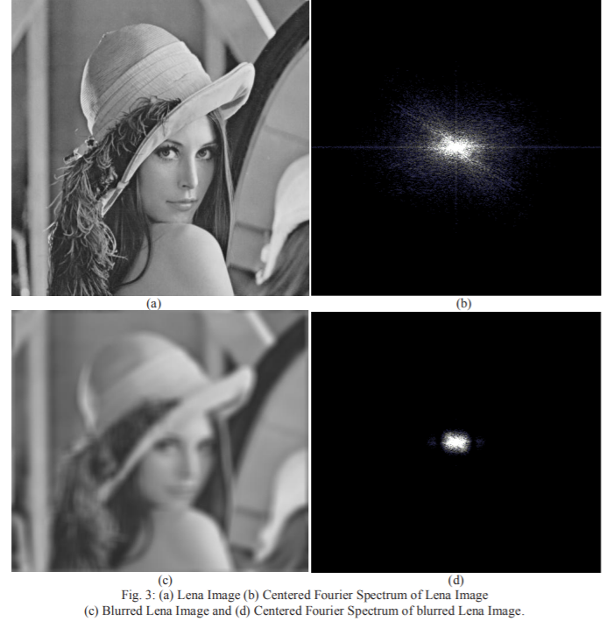
Blurred Image
Notes:
We will start with blurred images. There was research done in 2013 to measure image sharpness in the frequency domain. The researchers observed that when the blur of an image increases, the number of high frequency components in the image decreases. Meaning, a sharper, good quality image will have a higher number of high frequency components compared to a blurred image which will have a lower number of high frequency components. We can see that is true by the Fourier transform for these images.

Slide 3
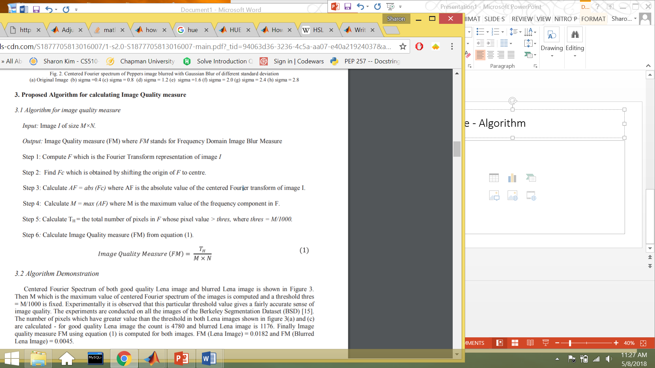
Blurred Image - Algorithm
Notes:
Based on the knowledge that higher frequency components mean a better quality picture, an image quality measure can be calculated. The steps of this algorithm are first finding the fourier transform of the image I. Then, taking the absolute value of the fourier. Next, calculating a threshold value – maximum value of the frequency component/1000. Then calculating the total number of pixels in F that are above the threshold value. The image quality measure (FM) is calculated by the total count divided by the dimensions of the matrix.

Slide 4
Blurred Image
Regular Image
T_{H} = 4780
FM = 0.0182
Blurred Image
T_{H} = 1176
FM = 0.0045
Notes:
So for the image of the girl, in the not blurred photo, the total number of pixels greater than the threshold was 4780, and for the blurred image, it was 1176. This gave us an image quality measure of 0.0182 and 0.0045. The closer the image quality metric is to 1, the less blurry the image is.

Slide 5
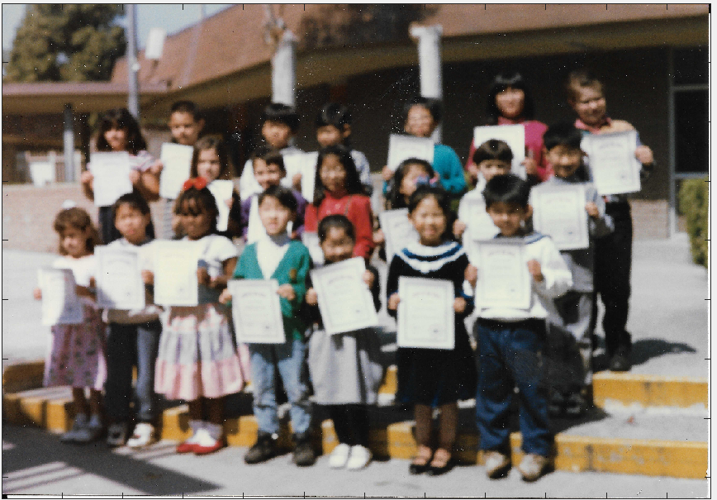
Blurred Image
T_{H} = 7385
FM = 0.0001003
Notes:
After looking over this research, I used matlab to explore the algorithm. For this blurry image, I calculated the number of pixels above my threshold was 7385, and then image score was 0.0001.

Slide 6
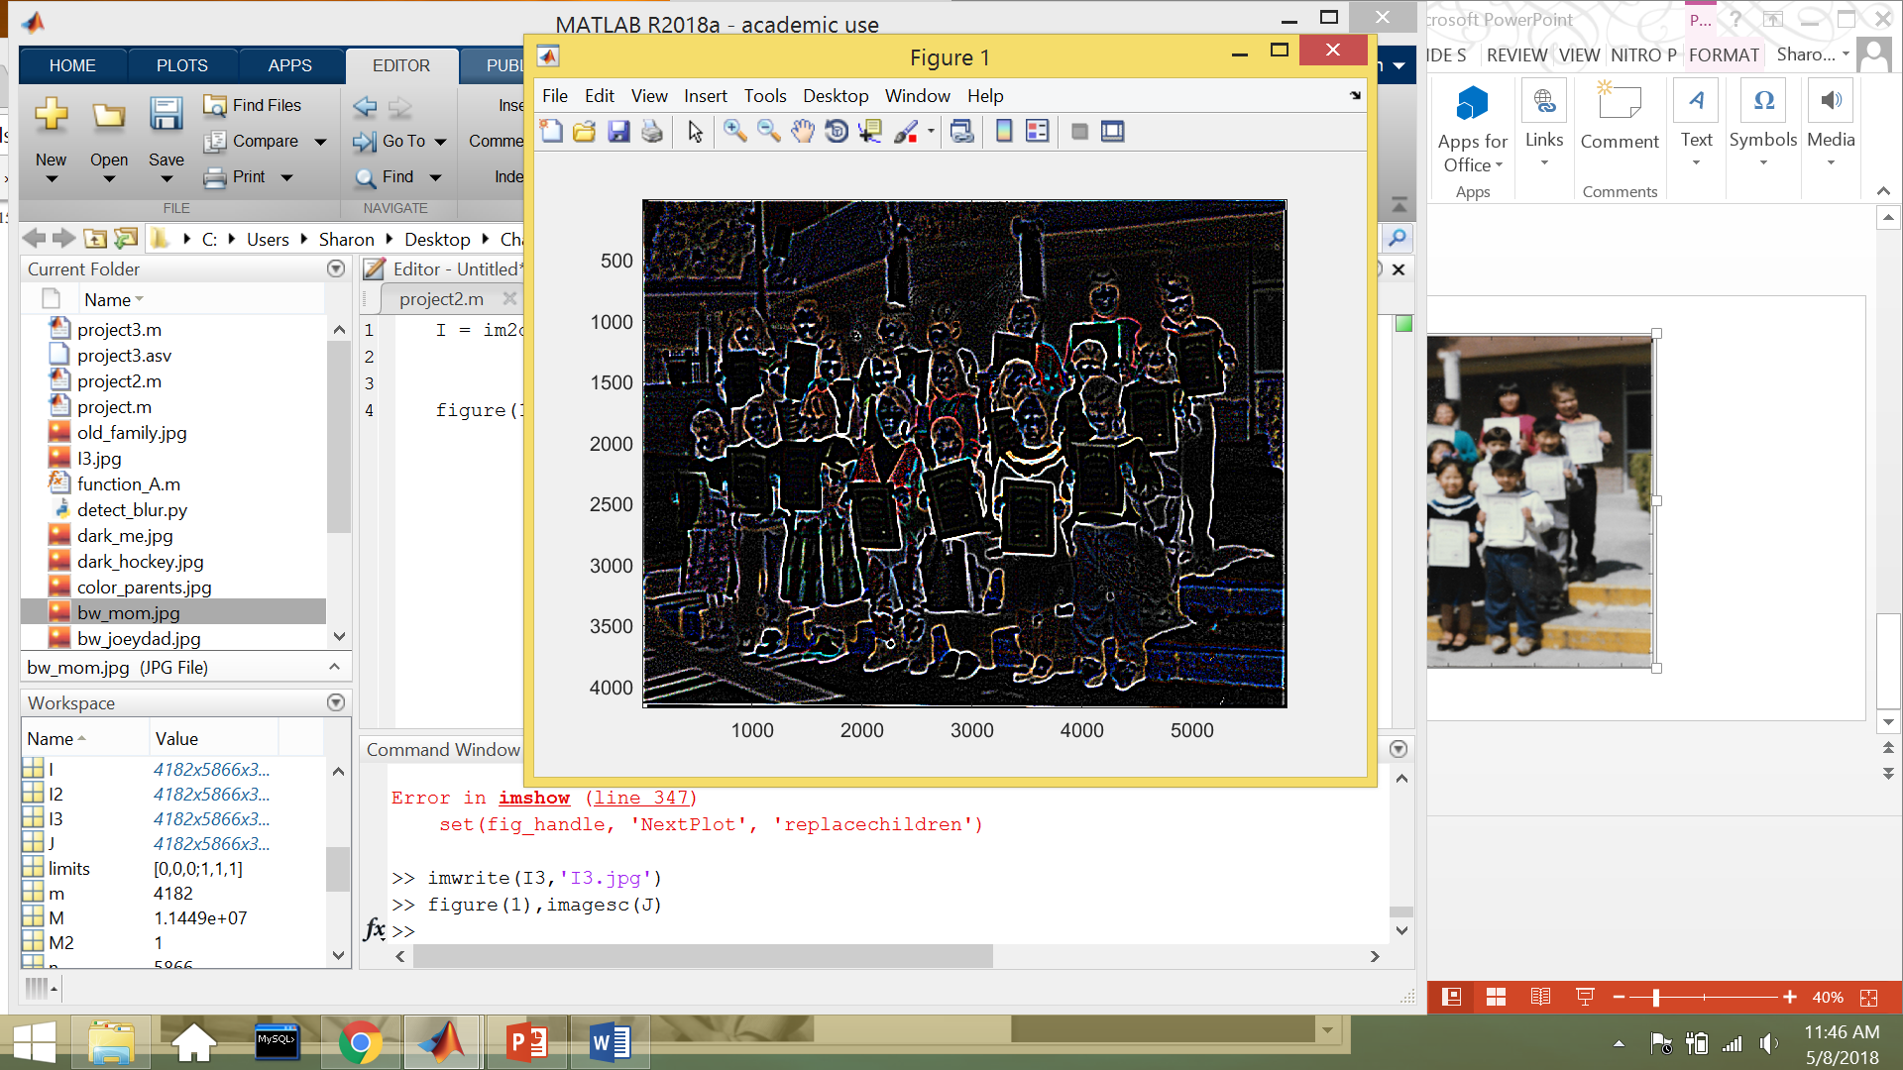
Laplacian
Notes:
I used the laplacian method to deblur and sharpen the image. Then I used a median filter to remove the noise, then I used a Gaussian filter to soften the image.

Slide 7
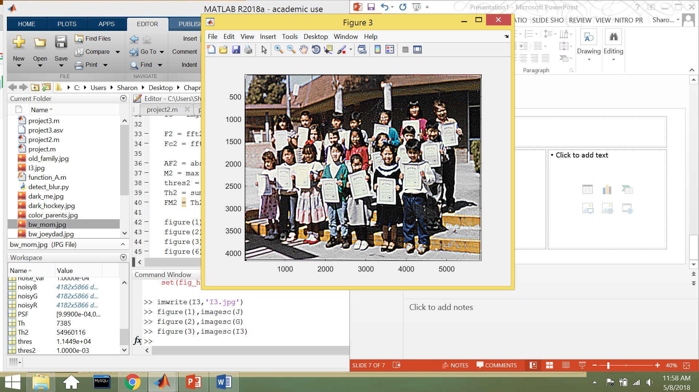
Blurred Image
T_{H} = 7385
FM = 0.0001003
Restored Image
T_{H} = 54960116
FM = 0.52076
Notes:
My results show that the algorithm does measure blurriness in image quality well. After deblurring the image, the image quality score improved from 0.0001 to 0.52.

Slide 8
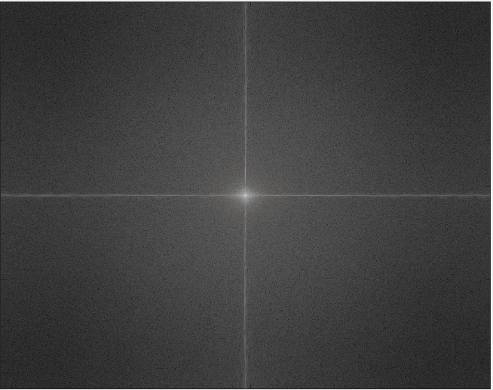
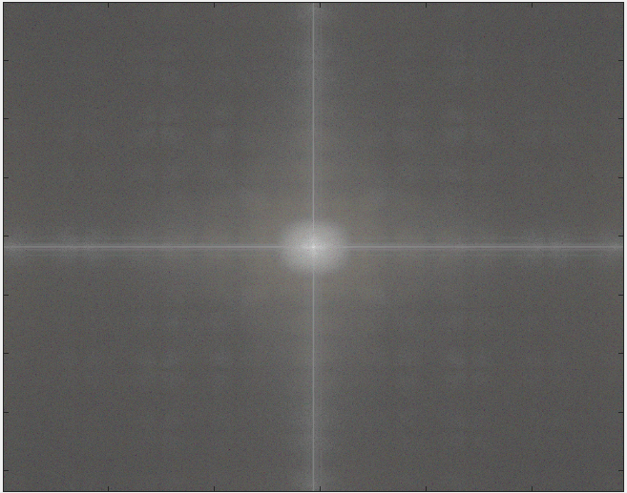
Notes:
You can also see in the fourier transform of these images. The blurred image had less high frequency values, where the clearer image had more high frequency values.

Slide 9
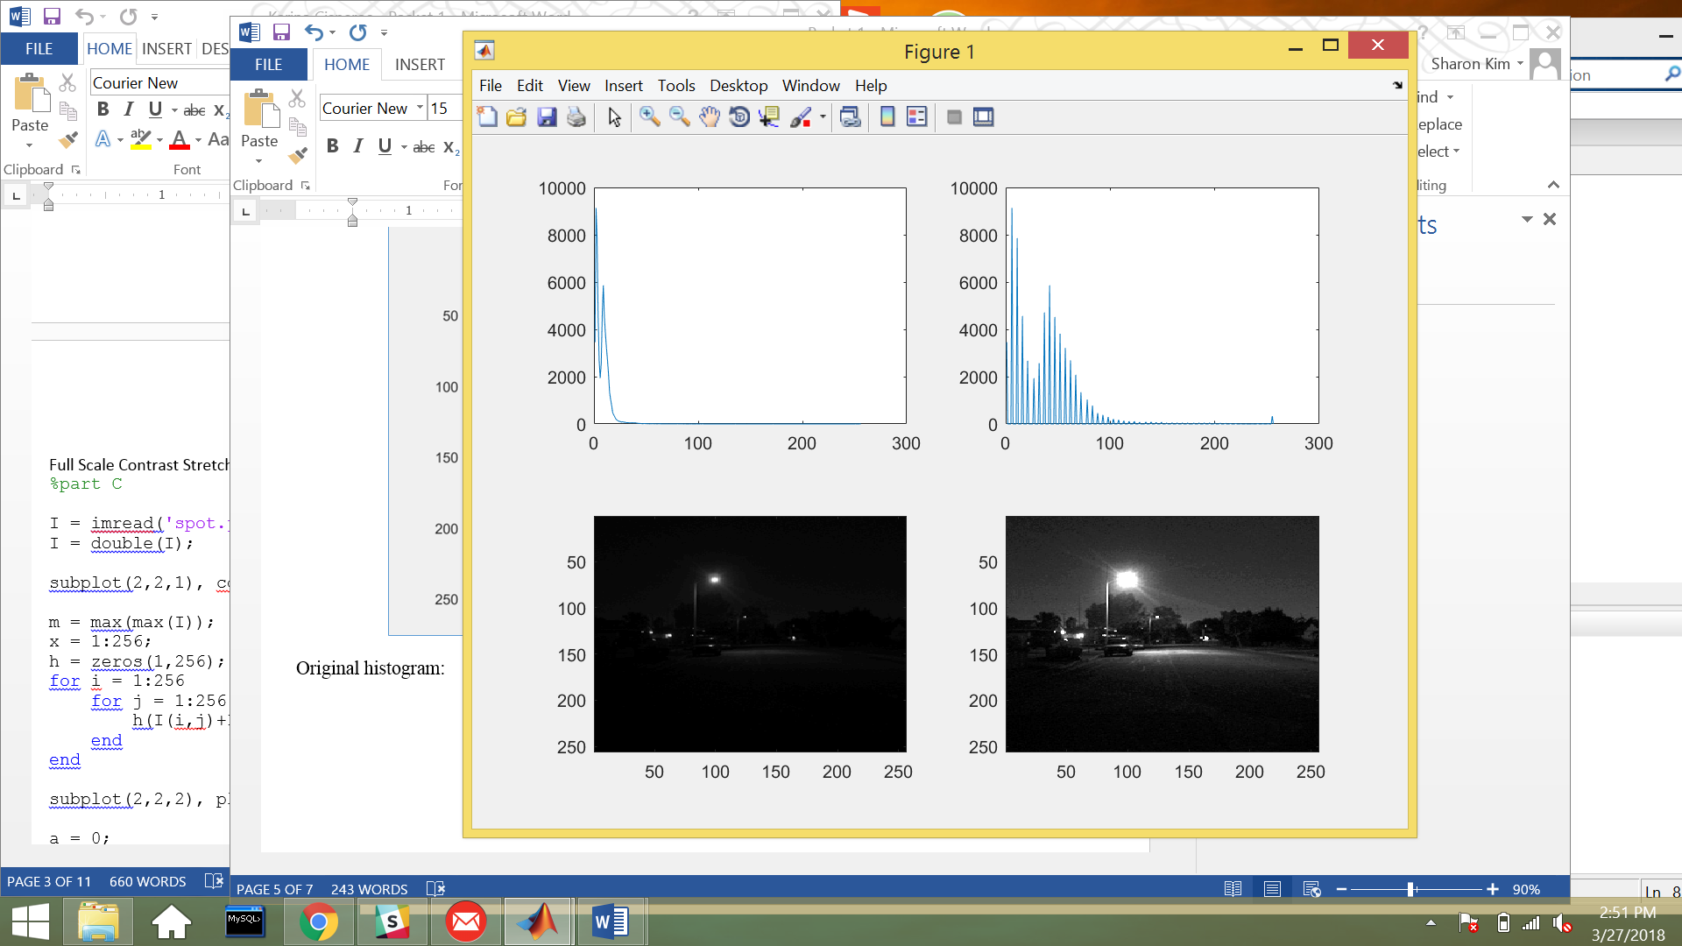
Contrast Stretching
Notes:
The next image enhancement process that I looked into was contrast stretching for color images.

Slide 10
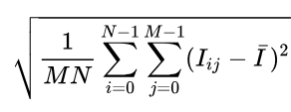
Contrast measure
Root mean square (RMS) contrast
Notes:
The contrast measure that I used was the Root Mean Square contrast. Root Mean Square contrast (RMS) is defined as the standard deviation of the pixel intensities in the image. The RMS measures the spread of the pixel values. This means that when the RMS is lower, the pixel values are spread out more evenly.

Slide 11
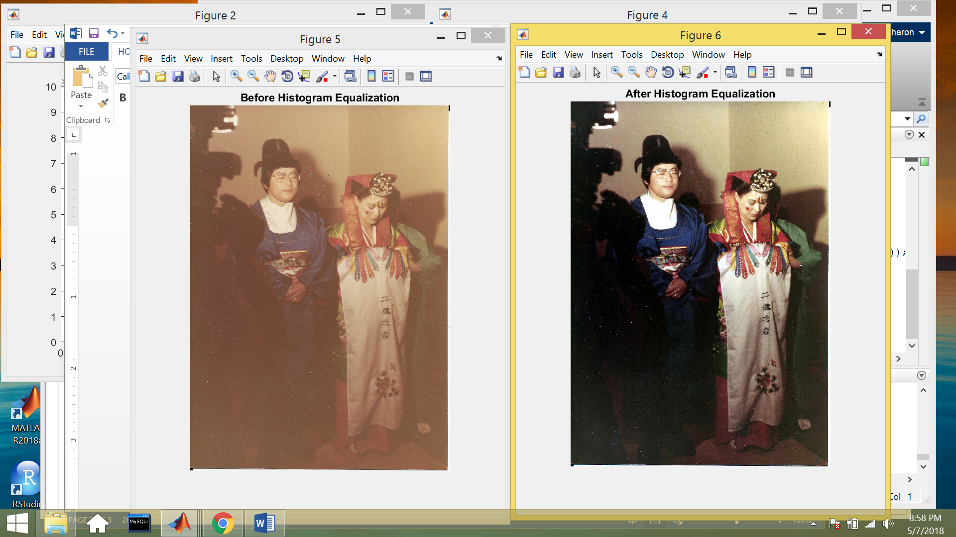
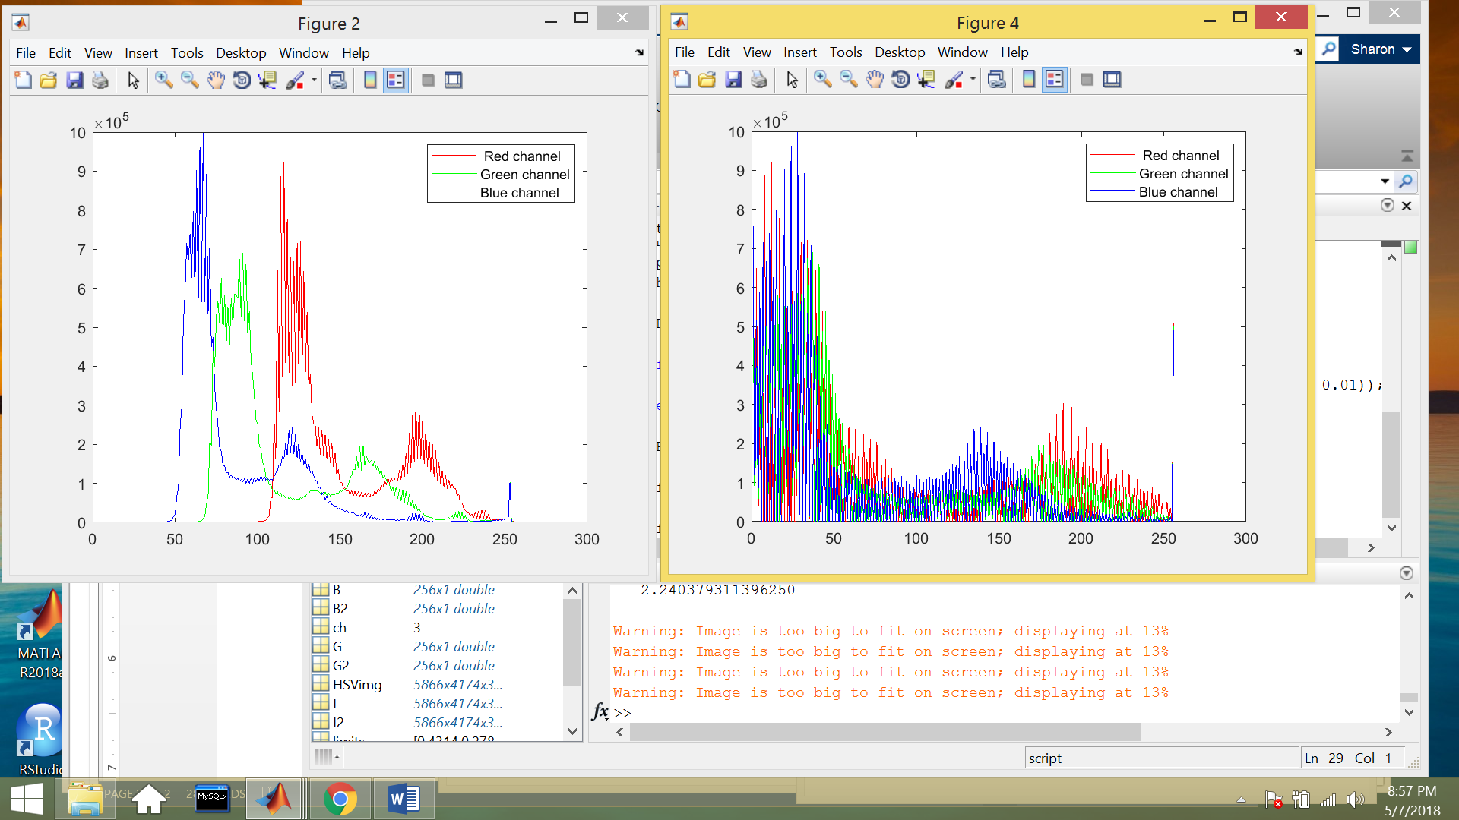
RMS = 15.9679
Notes:
For this image, you can see that the photo looks a bit washed out. You can see on the Red Blue Green histogram that the channels do not really fill the entire intensity range. The RMS is also calculated to be 15.96.

Slide 12
RMS = 0.3877
Notes:
After undergoing histogram equalization, we can see that the Red, Blue, Green channels are spread more evenly throughout the entire intensity range. The RMS also reduces down to 0.3877.

Slide 13
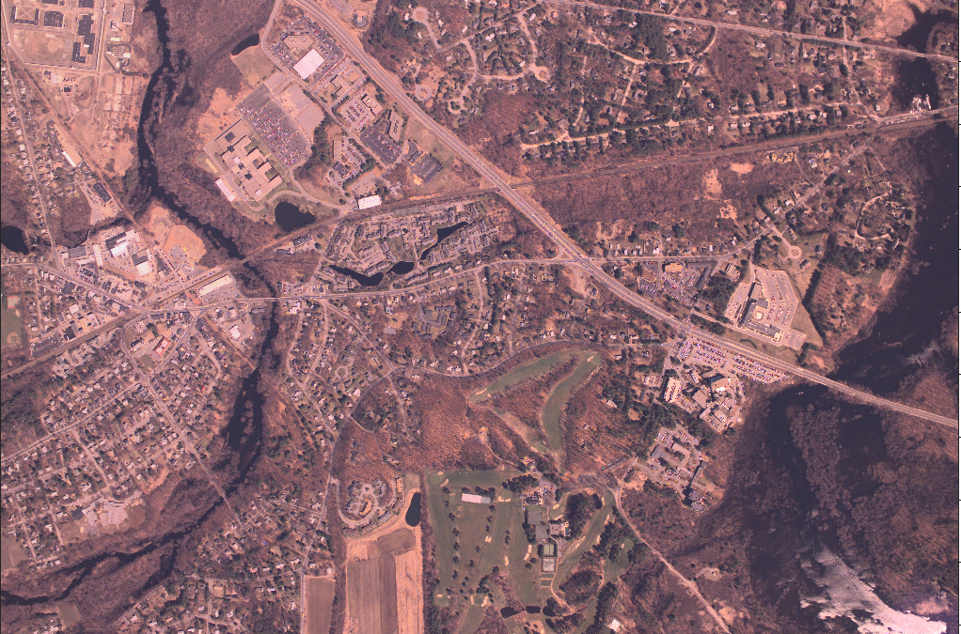
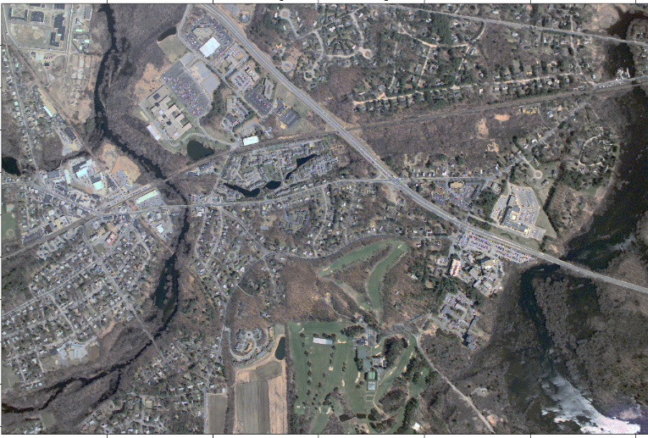
Color Cast Removal
Notes:
The next image enhancement process that I looked into was color cast removal. Color casting is when a tint of a particular color is cast on the entire image. Histogram of the grayscale image can be used to remove the color cast.

Slide 14
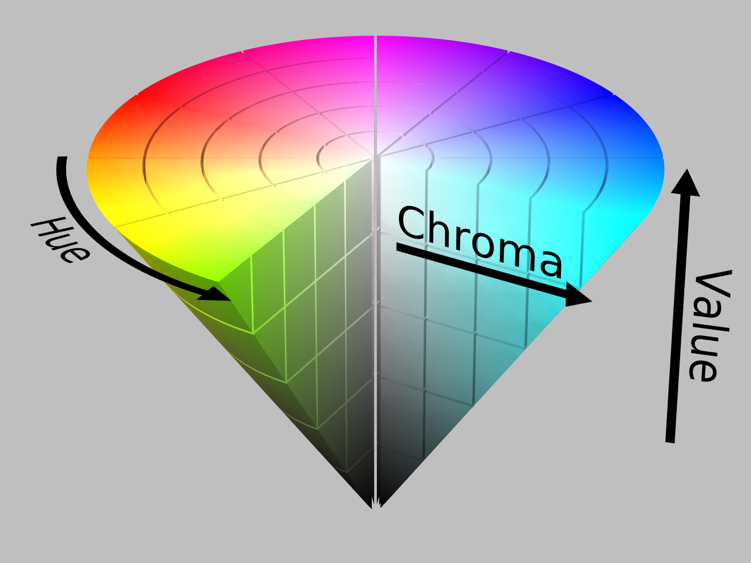
Color Cast Removal
Hue
Chroma/Saturation
Notes:
The two variables that I looked at were hue and chroma. Hue is basically the color of the image or pixel, and chroma is the intensity of the hue.

Slide 15
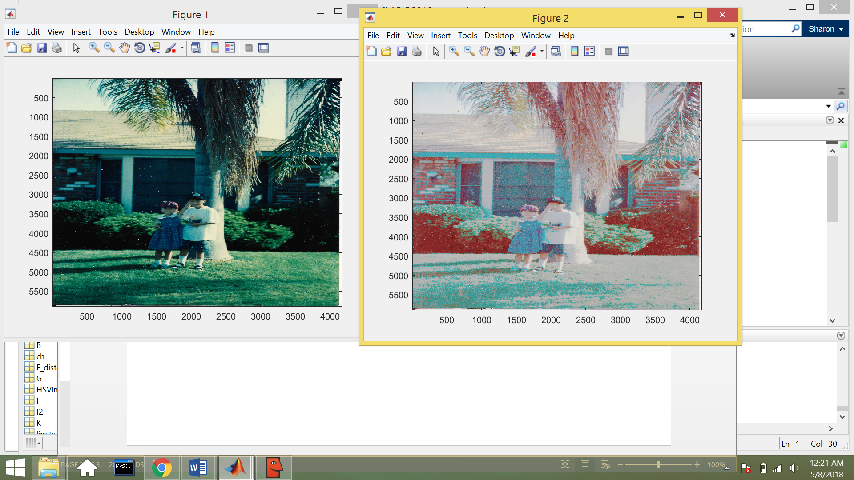
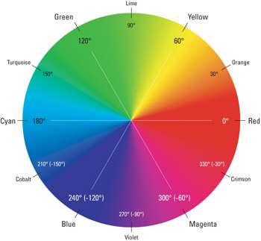
Hue Angle = 145º
Chroma/Saturation = 52%
Notes:
The image in this photo has a bluish green color cast. I found the average value of all the hues in the pixel to get a hue angle of 145 degrees which means the average hue of the picture is turquoise/green. I found the average value of the chroma was 52%.

Slide 16
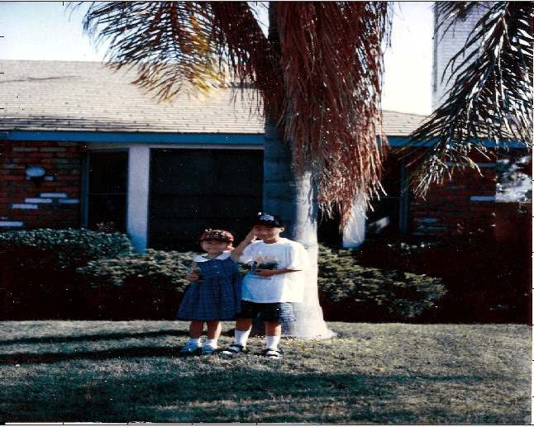
Hue Angle = 96º
Chroma/Saturation = 41%
Notes:
I used histogram matching through a grayscale image to perform color cast removal, and measured the hue and chroma again. The overall hue of the image changed to limeish yellow, and the chroma of the image reduced to 41%

Slide 17
Application
Blur
Image quality measure (FM)
Contrast Measure
RMS
Color Cast Removal
Hue & Chroma
Notes:
One application idea that I thought about was using these metrics to build better models that could classify the type of image restoration process that an image should undergo to increase image quality.

